Slide 1
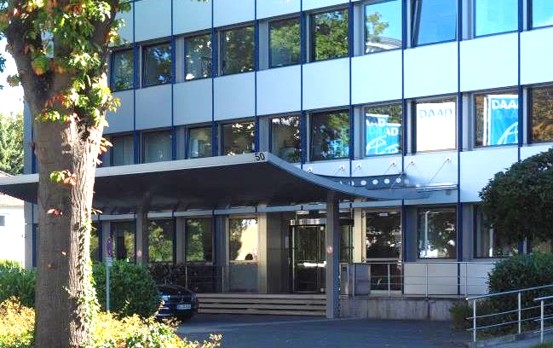
Presentation of the new DAAD Programme:
Higher education cooperation with Jordan and Lebanon to support Syrian university staff (2021–2022)
15.04.2021
Higher Education
in Syria after a decade of war
© Thomas Pankau, DAAD

Slide 2
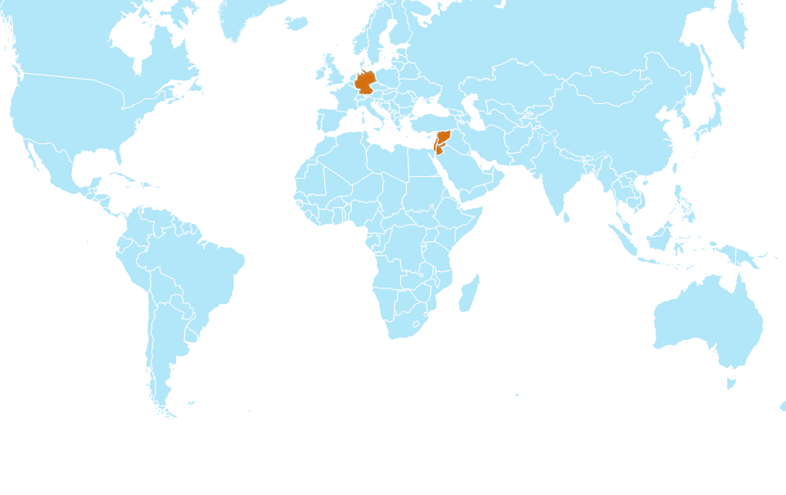
Higher education cooperation with Jordan and Lebanon to support Syrian university staff (2021–2022)
Initiation of Partnerships
Germany
Jordan, Lebanon, Syria

Slide 3
The German Academic Exchange Service
  The DAAD Programme:
  Higher education cooperation with Jordan and Lebanon to support Syrian university staff (2021–2022)
  Initiation of Partnerships
  Background
  Objectives
  Measures / Activities
  General Information

Slide 4
Background
Objectives
Measures / Activities
General Information
The civil war in Syria led to a permanent instability of the country which also affected the Syrian universities:
Destruction of parts of the university sector
destruction of university equipment
loss of qualified teaching staff
reduction in the quality of teaching
reduction in quality of the supervision of theses especially in the area of master’s and doctoral degree programmes

Slide 5
Background
Objectives
Measures / Activities
General Information
Due to the current political situation (EU restrictive measures), only indirect support for academic life in Syria is possible.
The programme is not intended to:
reconstruction of destroyed infrastructure
(i.e., Construction of university buildings, set up labs, libraries, modern classrooms etc.)
sponsor any sort of equipment for Syrian universities
finance and support University representatives and officials at Syrian universities
promote projects that aim directly at a reconstruction of the country’s infrastructure of any sort

Slide 6
Background
Objectives
Measures / Activities
General Information
Due to the current political situation (EU restrictive measures), only indirect support for academic life in Syria is possible.
The programme is intended to:
  promote cooperation between German and Jordanian/ Lebanese universities
  encourage them to include Syrian academics in their projects
  support the university staff of Jordanian, Lebanese and Syrian universities in improving the quality of teaching and research

Slide 7
Background
Objectives
Measures / Activities
General Information
- Initiation of Partnerships -
Long Term Objectives
  Objective 1: improving the quality of teaching at Syrian, Jordanian and Lebanese higher education institutions.
  Objective 2: improving the internationalization of the participating institutions.
  Objective 3: stabilizing the cooperation structures between the participating universities and other institutions.

Slide 8
Background
Objectives
Measures / Activities
General Information
Short Term Objectives
  Programme objective 1: Initial steps are taken in the further qualification of Syrian academics in accordance with the state of scientific knowledge.
  Programme objective 2: Initial steps are taken in the qualification of teaching staff at partner higher education institutions in terms of subject matter, didactics and administration.
  Programme objective 3: Initial steps are taken in the further development of teaching and research.
  Programme objective 4: Subject-related networks between the participating higher education institutions and other institutions have been established.

Slide 9
Background
Objectives
Measures / Activities
General Information
Measures / Activities (examples)
  Training and education courses;
  The joint (further) development of curricula/teaching modules that correspond to the local context and the state of scientific knowledge;
  First agreements on the preparation of educational materials (e.g., curricula, blended learning);
  Establishing and / or extending individual contacts between participating universities and other institutions

Slide 10
Background
Objectives
Measures / Activities
General Information
Activities that are Eligible for Funding
  Participation in and/or organisation of events, work meetings and workshops (e.g. special courses, summer and winter schools, study trips, conferences, etc.) in Germany, Jordan and/or Lebanon;
  Planning, development, implementation and/or further development of digital and non-digital courses;
  Developing educational materials;
  Implementation of online courses or digital laboratories;
  Teaching activities by German, Jordanian and/or Lebanese academic personnel or lecturers;
  Mobility and visits by German, Syrian, Jordanian and/or Lebanese students, graduates, PhD students, academics and researchers and/or university personnel.

Slide 11
Background
Objectives
Measures / Activities
General Information
Current Projects within this Programme:
  Philipps-Universität Marburg: PIANO - Pharmazeutische Initiative für die Arzneipflanzen des Nahen Ostens in Forschung und Lehre
  (Pharmaceutical initiative for the medicinal plants of the Middle East in research and teaching)
  Magdeburg-Stendal University of Applied Sciences: German Jordanian Applied University Teaching
  Brandenburg University of Technology: Urban and Architectural Heritage
  Saarland University: JUICEE Developing Jordanian Universities Innovation Capacities and Entrepreneurship Education

Slide 12
Background
Objectives
Measures / Activities
General Information
Current Projects within this Programme:
  Frankfurt University of Applied Science: Transnationalism and Localization in Social Work: Focus in Syrian Refugees
  TU Berlin: Building Refugees Integration through urban development and social Work (BRICK) Die Technologie der Datenerfassung für nachhaltige Entwicklung und Krisenmanagement
  FU Berlin: GEO-IT - Die Technologie der Datenerfassung für nachhaltige Entwicklung und Krisenmanagement
  (The technology of data collection for sustainable development and crisis management)
  Nuertingen-Geislingen University (NGU): Middle East Partnership for Productive Landscapes - Validating ecosystem services for sustainable growth and climate resilience

Slide 13
Background
Objectives
Measures / Activities
General Information
Programme Information
  Only German Institutions of Higher Education were eligible for applying
  Support is provided as full financing.
  The funding-period began on 01/01/2021 and ends on 31/12/2022
  The DAAD grant is generally limited to a maximum of 100,000 Euros per year.
  The programme is open to all subject areas.
  Target groups are Bachelor’s and/or Master’s students, PhD students, postdocs, habilitation candidates, academics, researchers and professors, etc.

Slide 14
Background
Objectives
Measures / Activities
General Information
Section P24 – Cooperation Projects in the Middle East, Asia, Africa and Latin America
  Kennedyallee 50, 53175 Bonn, Germany
  Head: Dr. Reinhard Babel
  Email: babel@daad.de
  Administration: Eva-Maria Hoppe
  Email: hoppe@daad.de
  Team Leader: Dr. Johannes Sczyrba
  Email: sczyrba@daad.de

Slide 15

Any questions?
15

Slide 16

Thank you for your attention
Dr. Reinhard Babel
Section P24
Deutscher Akademischer Austauschdienst (DAAD)
German Academic Exchange Service
Kennedyallee 50
53175 Bonn
  www.daad.de
© Michael Jordan

